Slide 1

Picture This!
Instruction Librarians Promoting
Academic Integrity
Amanda B. Click
ELIME Fellow
School of Information & Library Science
University of North Carolina at Chapel Hill
Claire Walker
Research & Instruction Librarian
Lila D. Bunch Library
Belmont University
Image: http://v4.jasonsantamaria.com/articles/shake-it-like-a-metaphorical-picture/

Slide 2


About...
Us
Our institutions
This study

Slide 3
Study Results
Belmont University (6 total)
1 freshman, 1 sophomore, 3 juniors, 1 senior
3 music major, 2 music business, 1 entrepreneurship
The American University in Cairo (8 total)
2 freshmen, 2 sophomores, 1 junior, 3 seniors
3 undeclared, 1 political science major, 2 communication & media arts, 1 art, 1 journalism

Slide 4
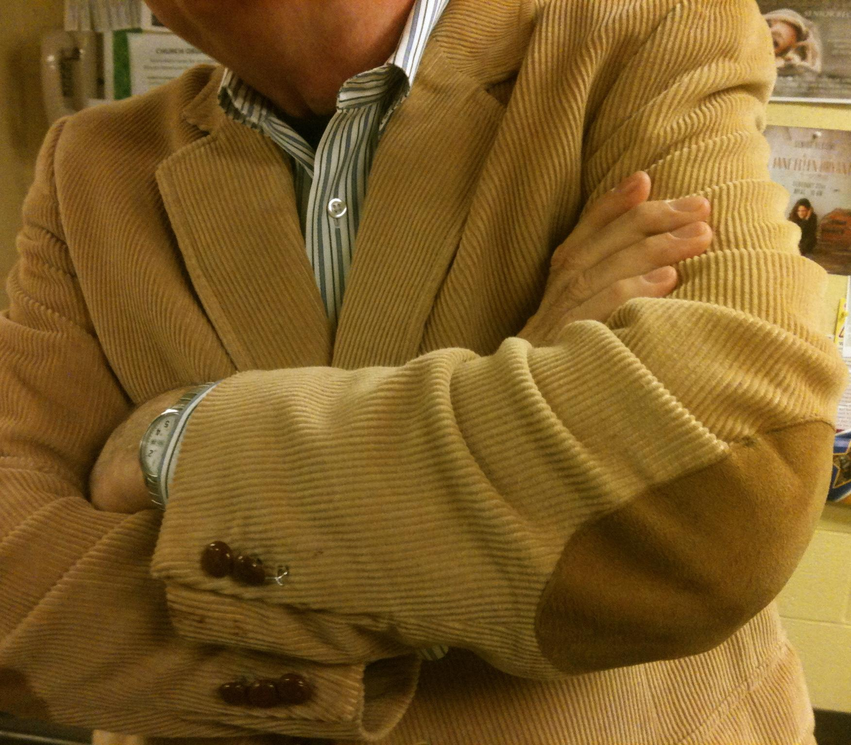
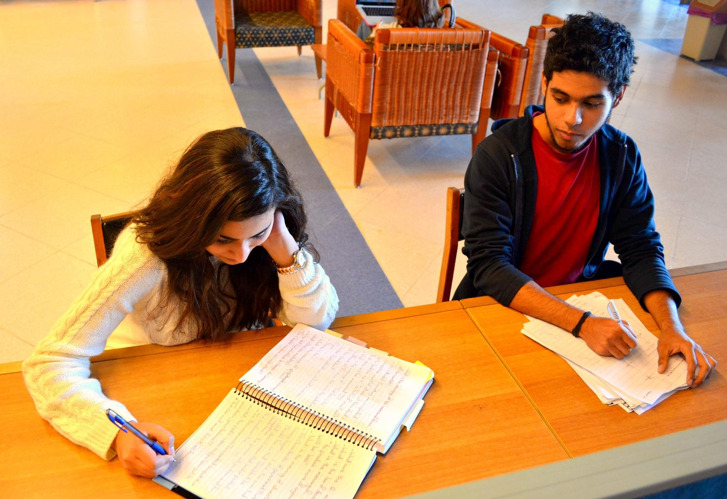
"How I feel about cheating"
AUC, freshman, undeclared.
BU, senior, music.

Slide 5
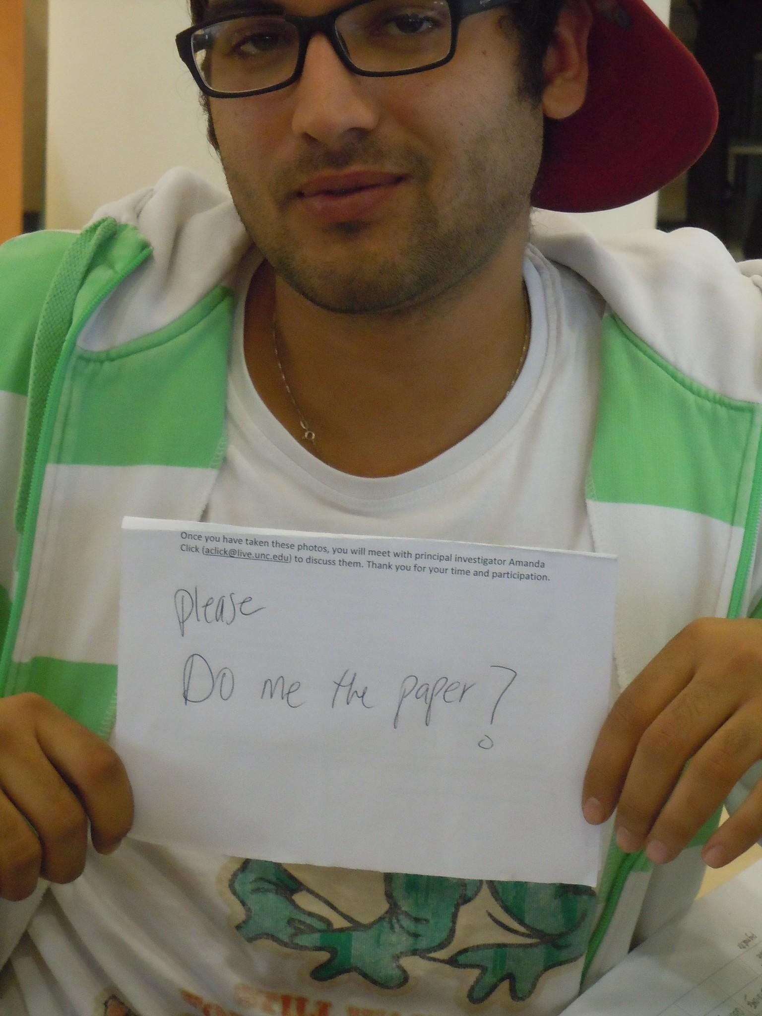
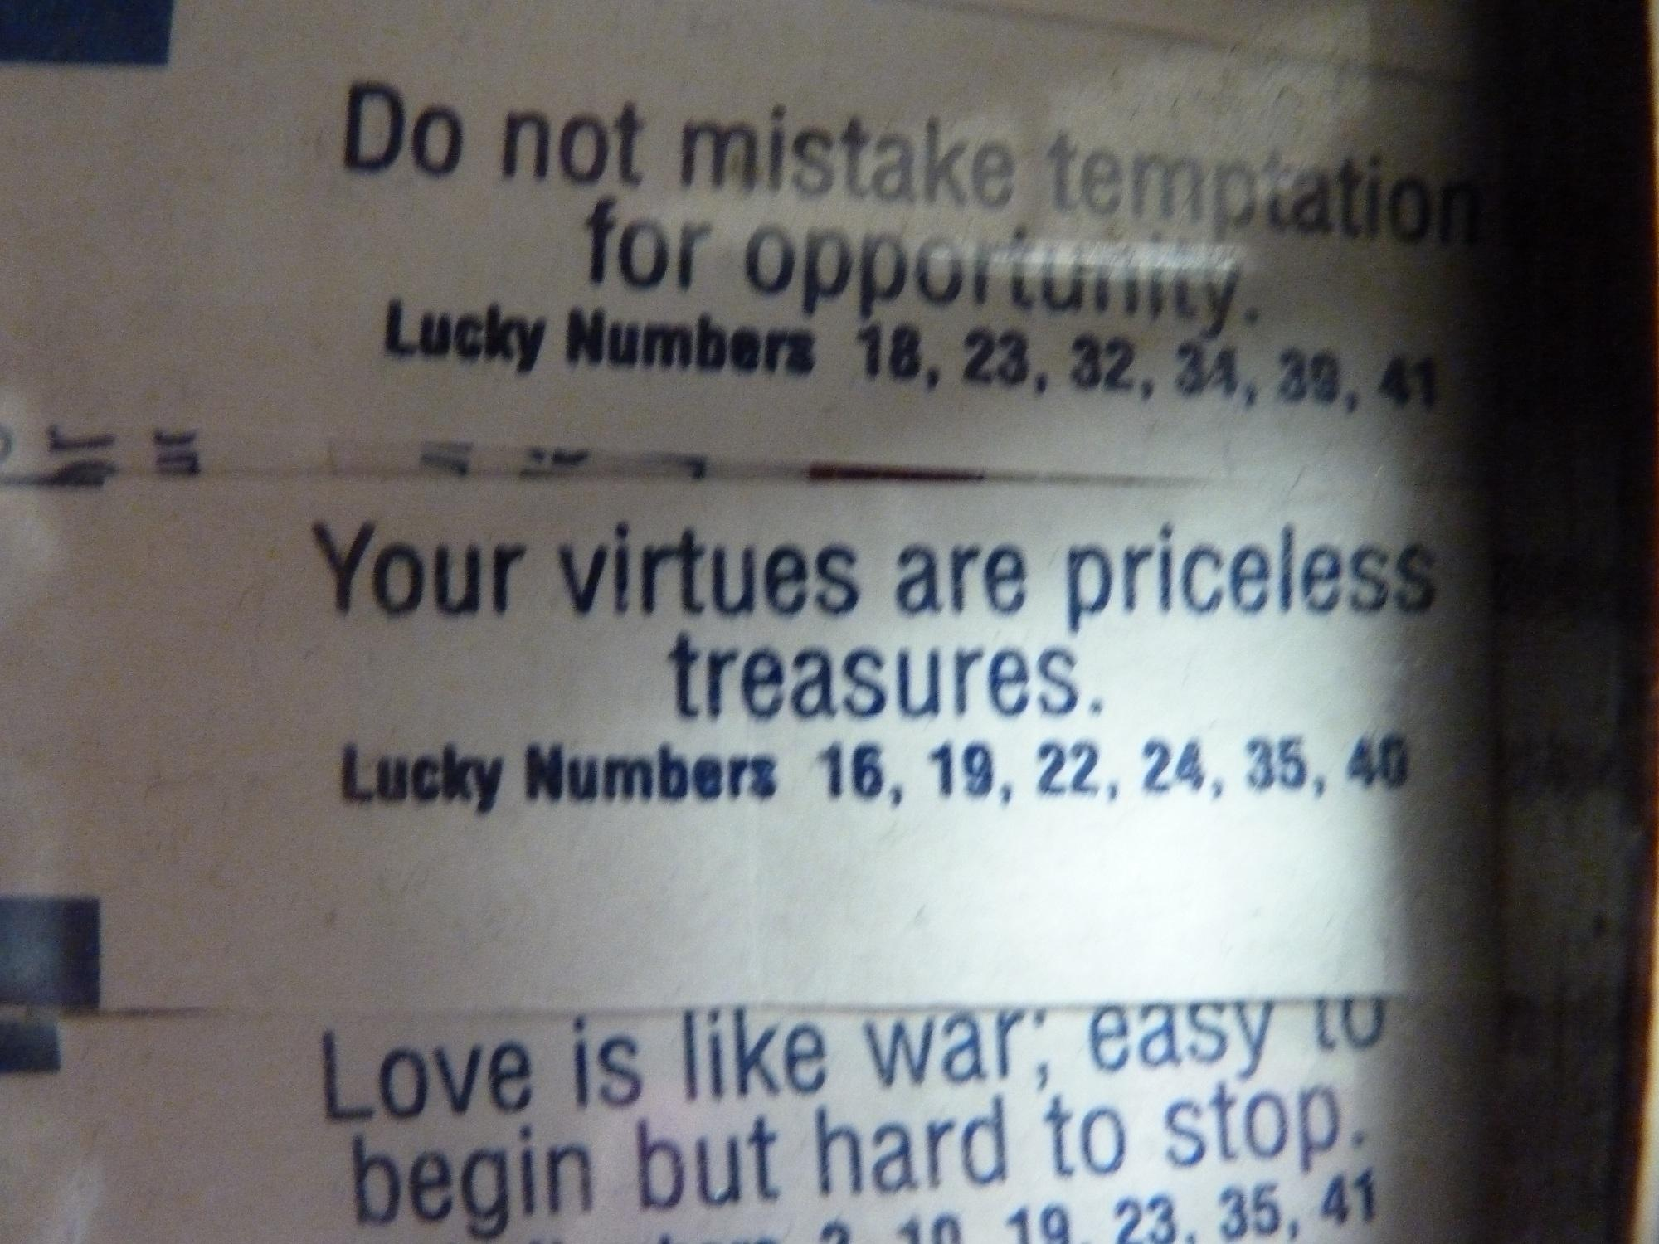
"How I feel about cheating"
BU, junior, music.
AUC, senior, art.

Slide 6
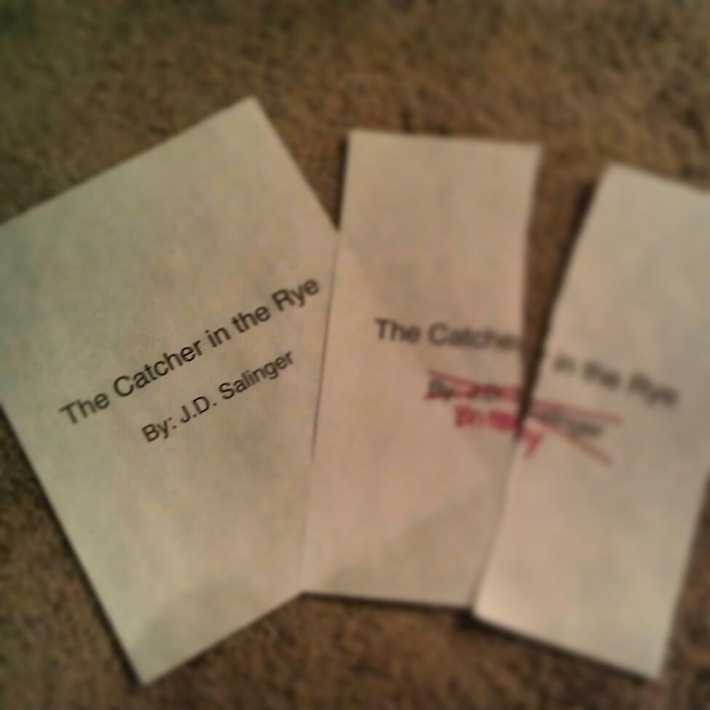
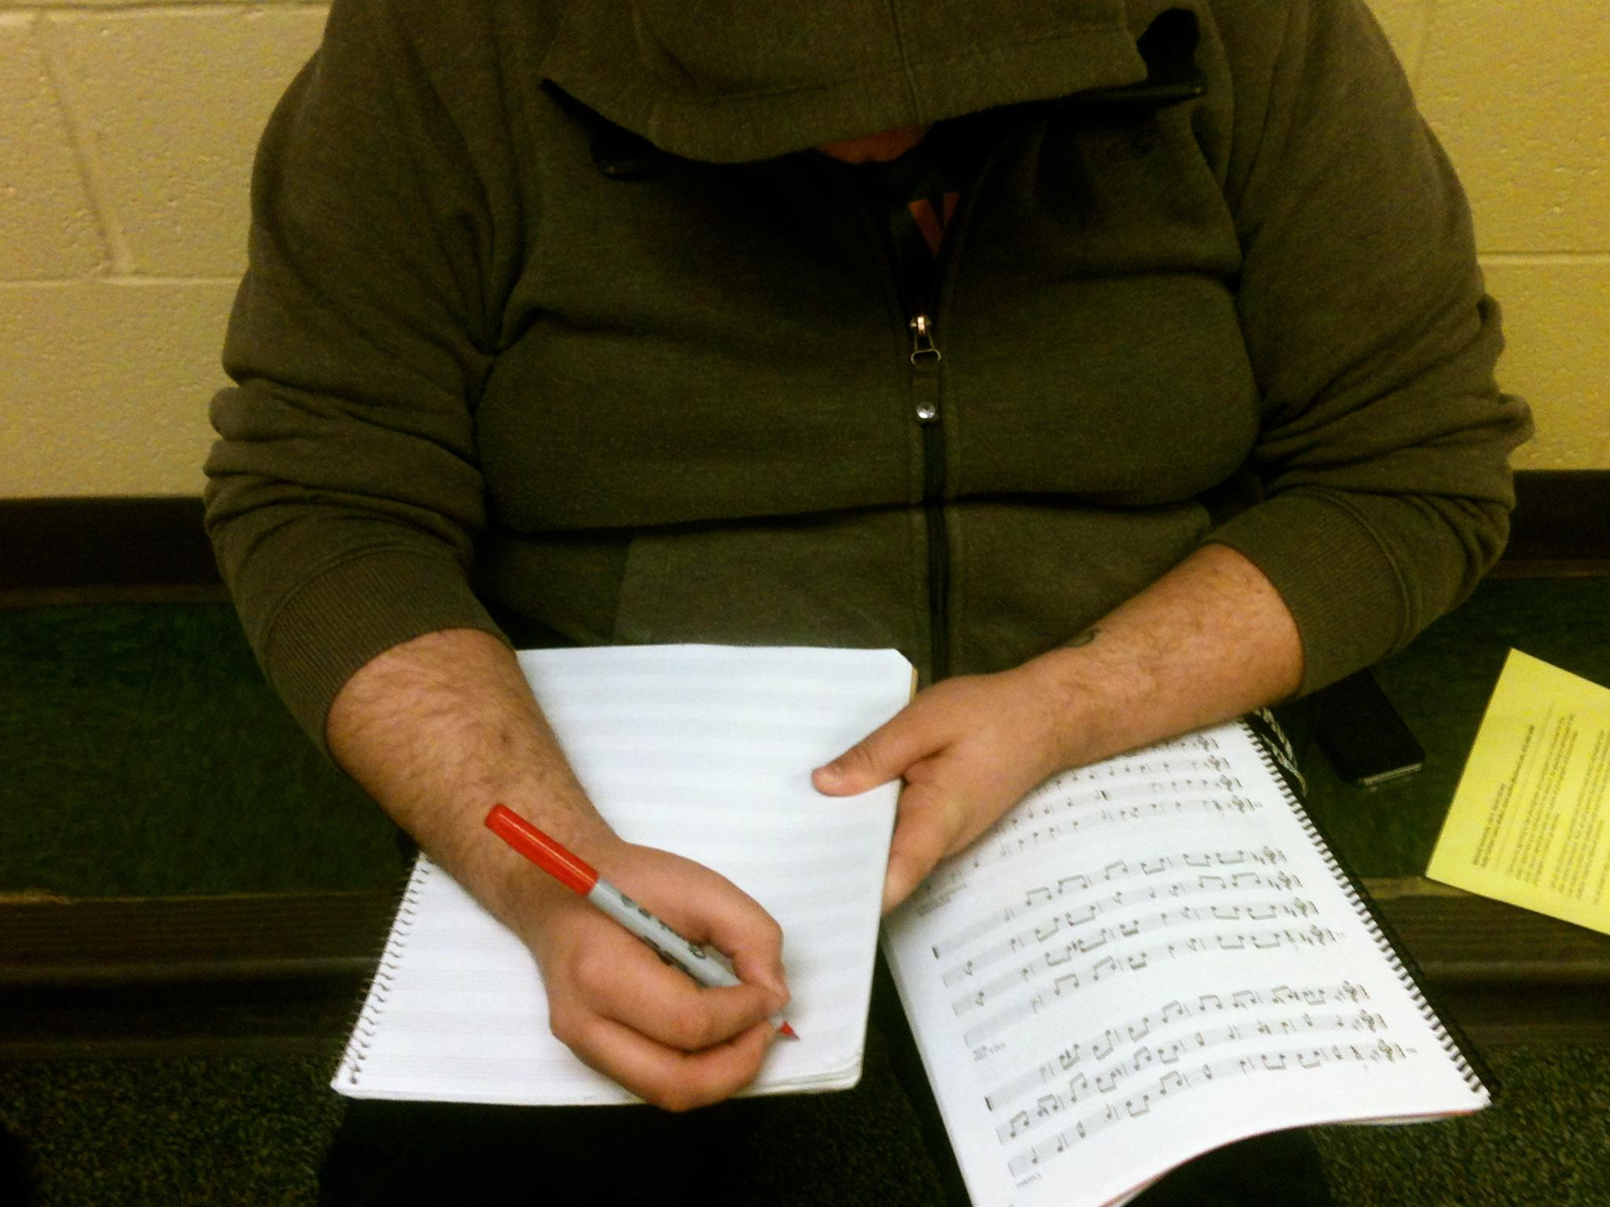
"How I feel about plagiarism"
BU, senior, music.
BU, junior, music.

Slide 7
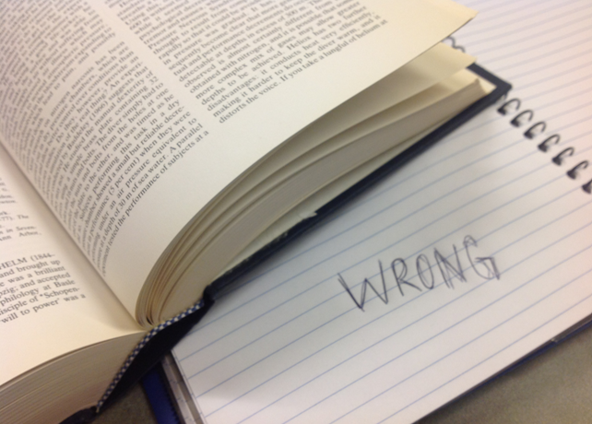
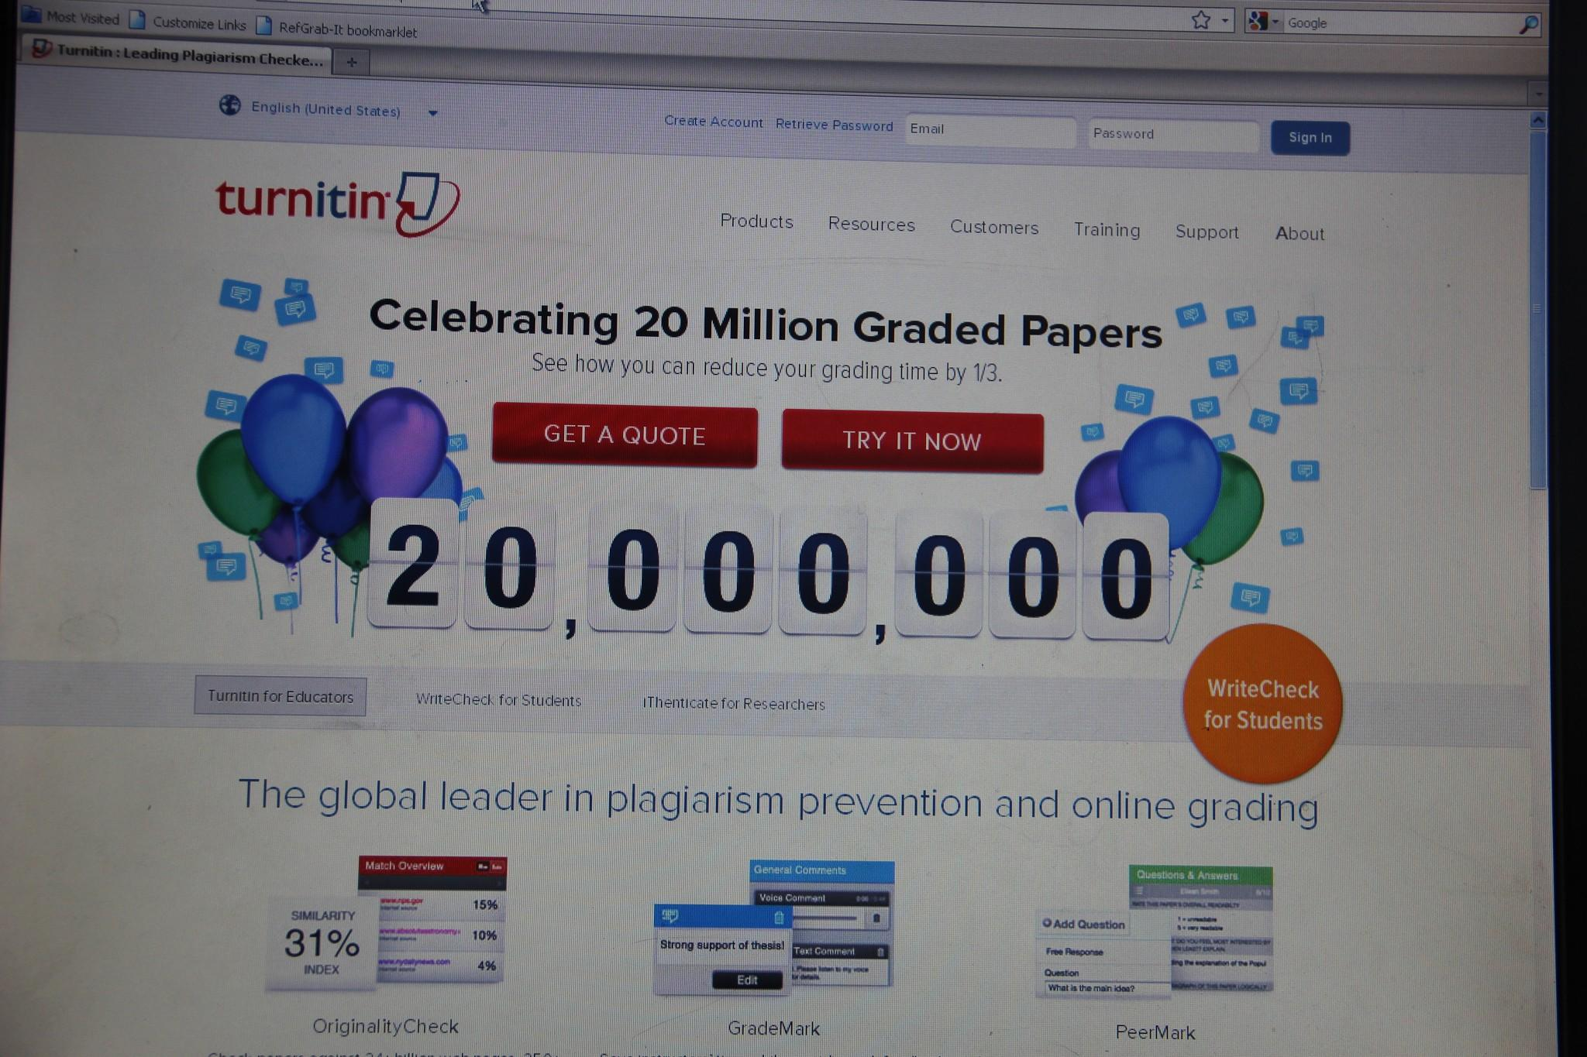
"How I feel about plagiarism"
AUC, freshman, undeclared.
BU, freshman, music business.

Slide 8
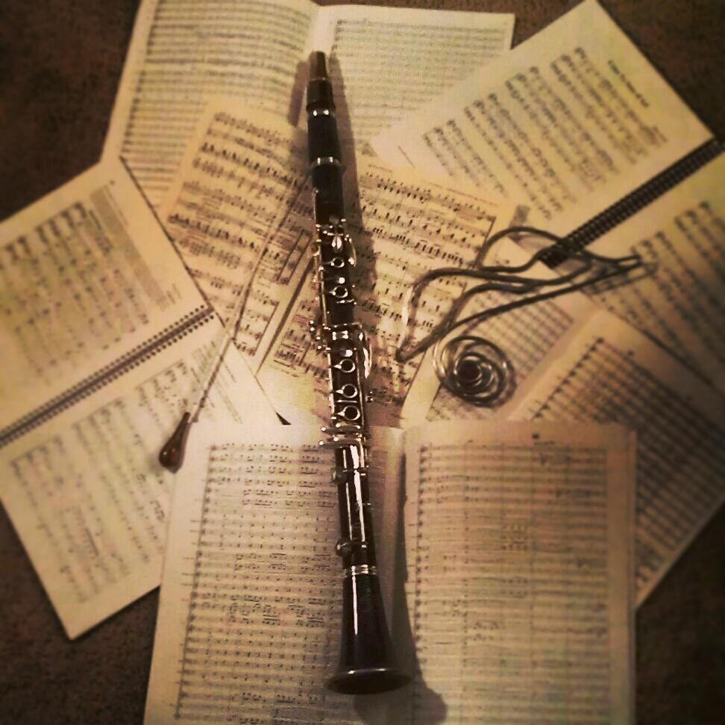
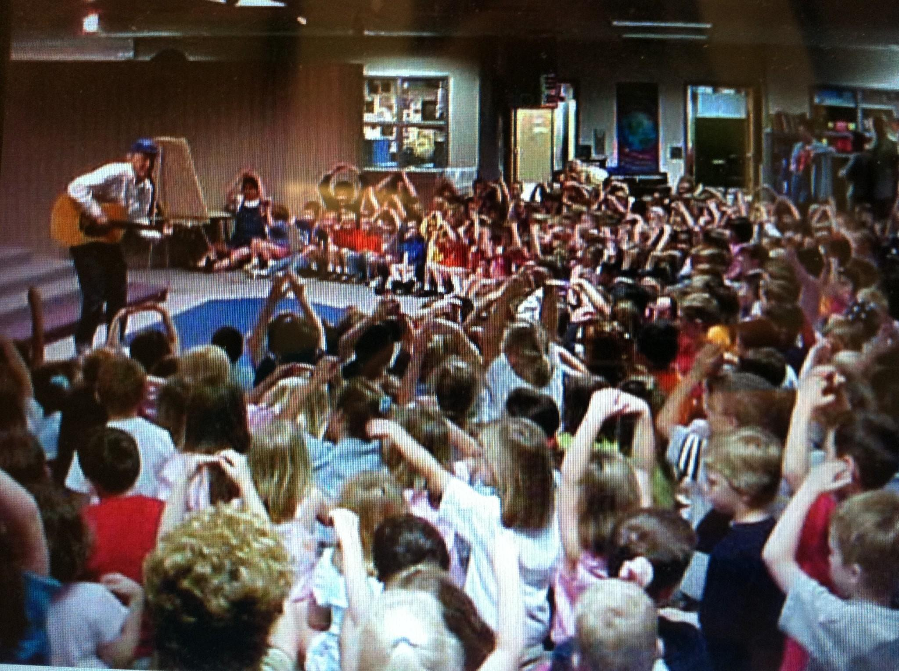
"How I learned about academic integrity"
BU, junior, music business.
BU, senior, music.

Slide 9
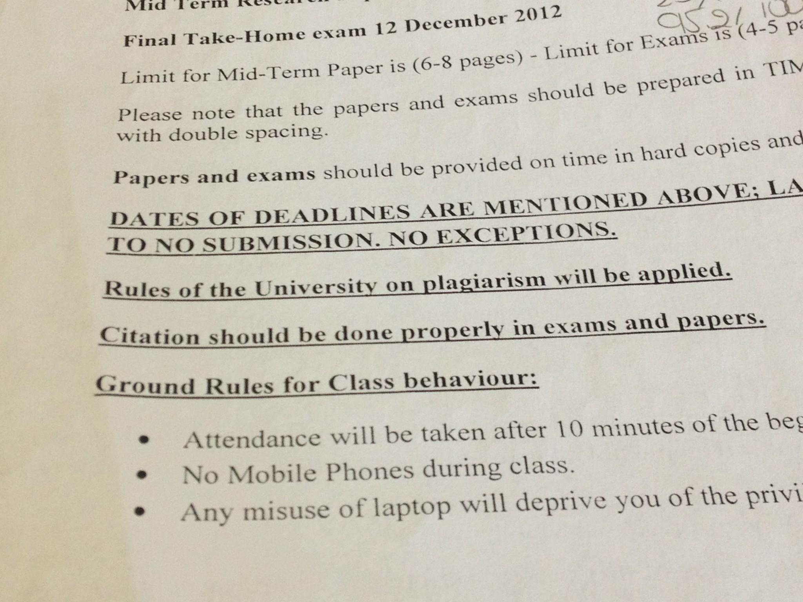
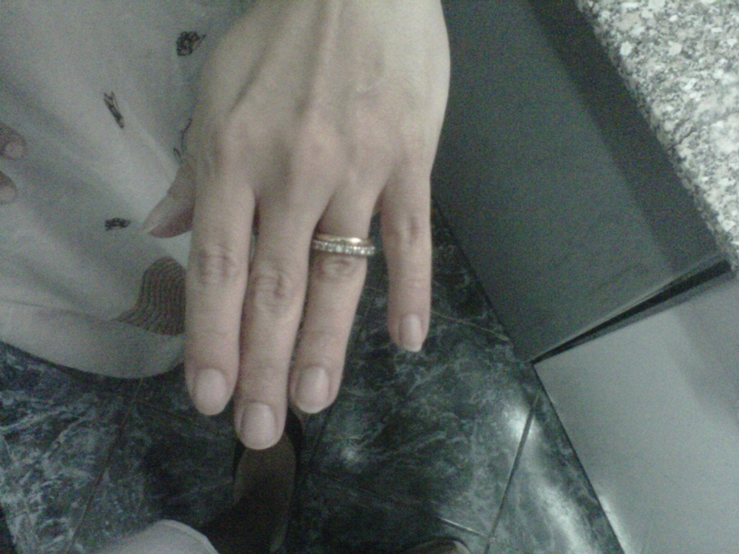
"How I learned about academic integrity"
AUC, sophomore, undeclared.
AUC, junior, political science.

Slide 10
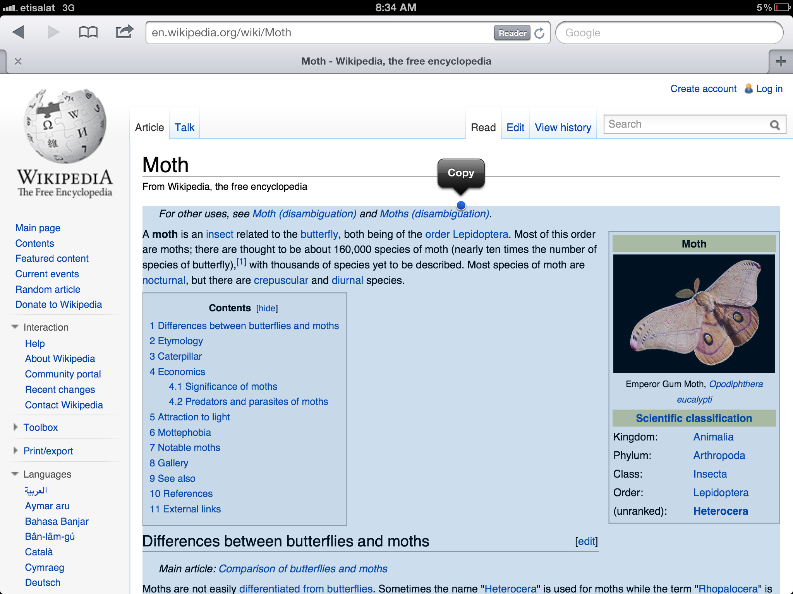
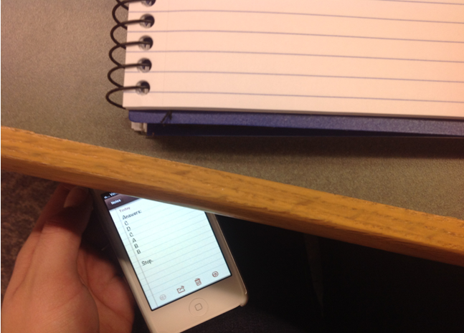
Themes: Specific behaviors
BU, freshman, music business.
AUC, freshman, undeclared.

Slide 11
Themes: Why students cheat
“I think it comes back to the thought of too much pressure. But that’s never gonna be eliminated, you know, college functions on competition.”
-BU, junior, music business
"Time management is a problem, and organization. And so, the easiest thing is just to copy anything off the net or use someone else's ideas and not give credit."
- AUC, sophomore, undeclared

Slide 12
Themes: The "trap" of plagiarism
"Plagiarism is more this looming thing where you might be plagiarizing and you might not even know. Plagiarism I think is a little harder to tell when it’s happening.”
-BU, junior, music business
“I feel like you can plagiarize something without necessarily knowing it."
-BU, sophomore, entrepreneurship

Slide 13
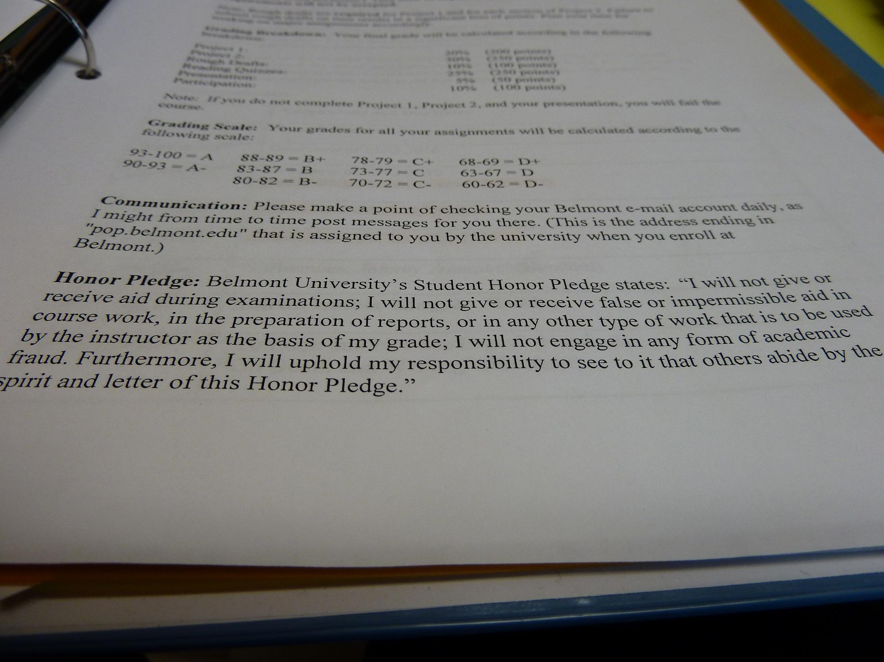
Themes: Definitions of academic integrity
“I think it’s just a lot of rules. I think the only way to define that is by setting a bunch of rules and having people follow them.”
- BU, junior, music business
"I mean, you're supposed to be creative in what you do and use your own ideas...and so I really hate when someone uses someone else’s ideas."
- AUC, sophomore, undeclared
BU, junior, music.

Slide 14
Themes: Belmont specific
High school influence
Creativity as motivation
Money

Slide 15
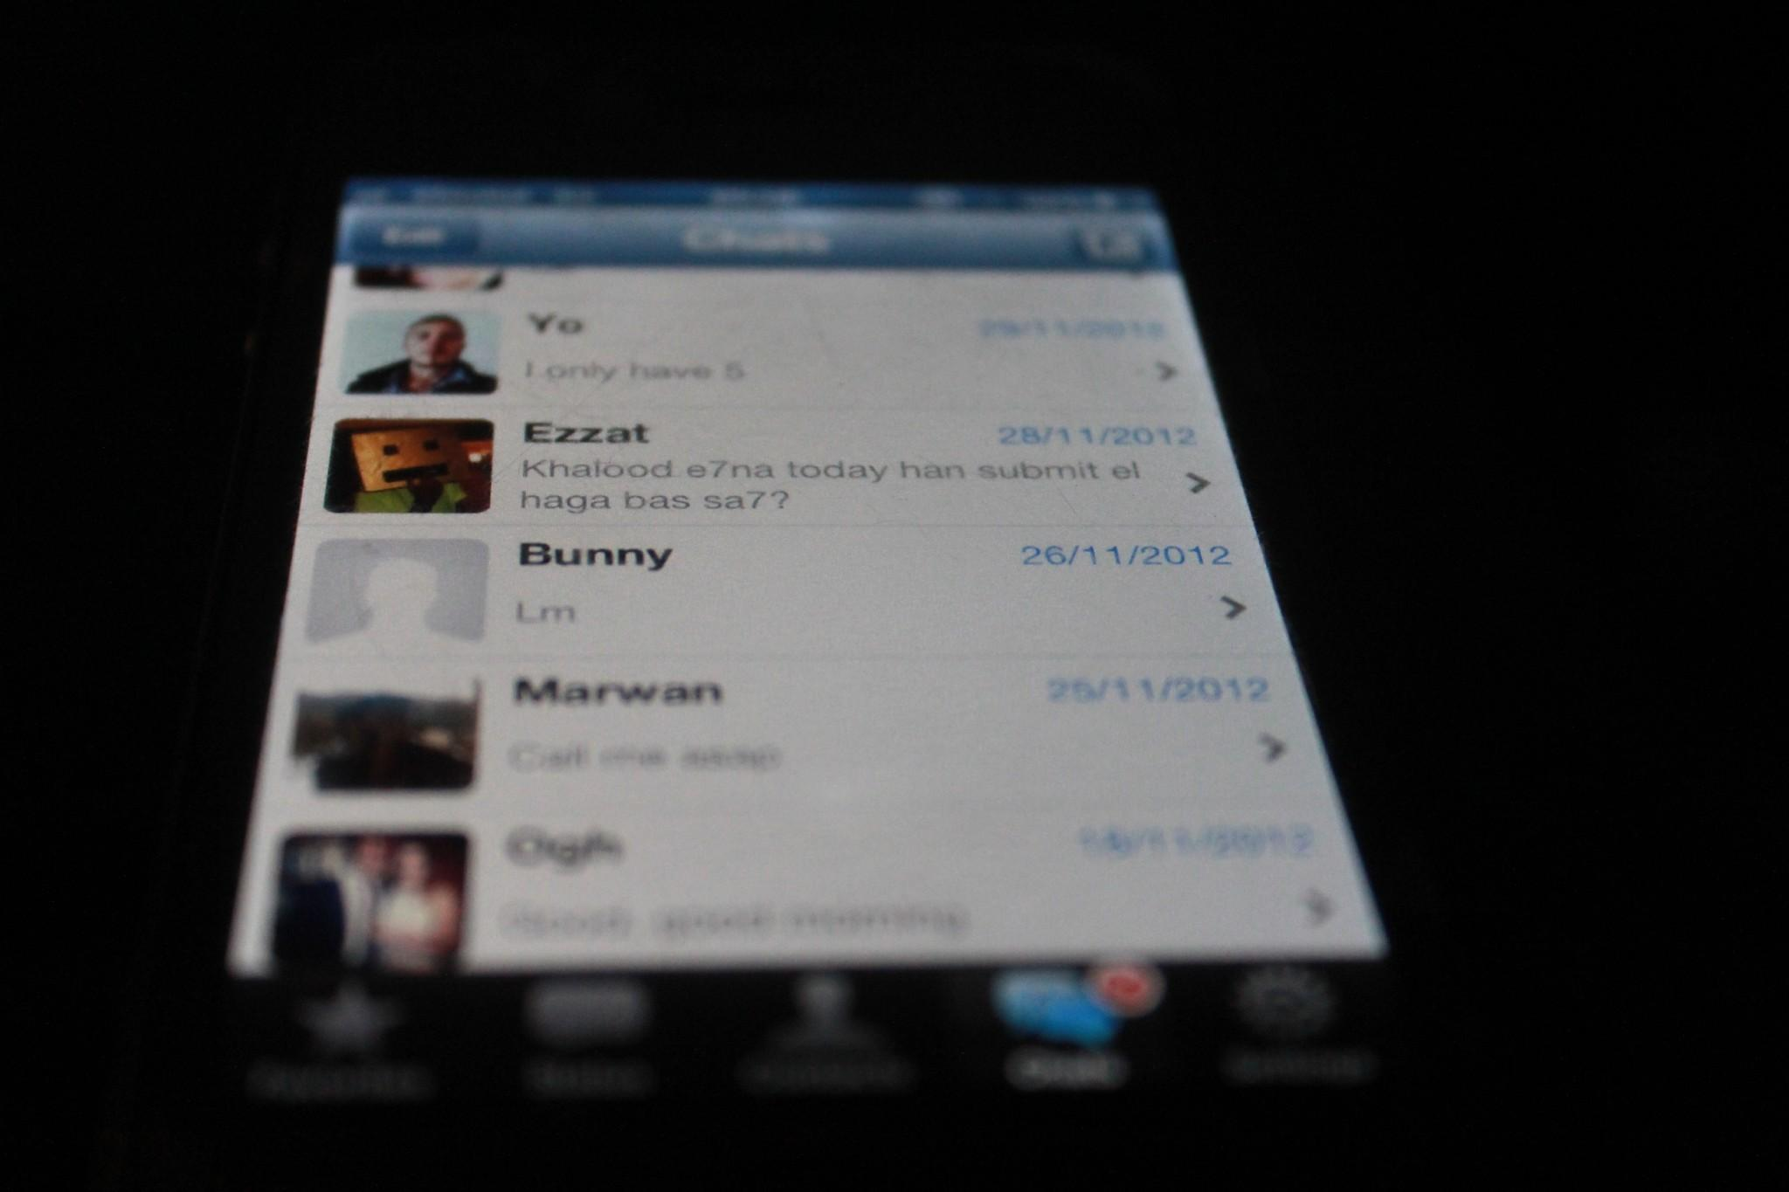
Themes: AUC specific
Turnitin.com
Giving credit where credit is due
Not an issue until university
Smartphones
Lack of interest in schoolwork
AUC, senior, journalism.

Slide 16
What can librarians do?
Integrate academic integrity into information literacy instruction
Think about the old rules and new kinds of information
Outreach to high schools
Don’t just point students to a database

Slide 17
Collaboration Opportunities
Offer workshop series for faculty, staff and students
Work with faculty to develop better assignments
Think about academic integrity instruction as discipline-specific

Slide 18
Thank you!
Questions? Comments?
Amanda Click
aclick@live.unc.edu
Claire Walker
claire.walker@belmont.edu

